Slide 1
RANKL/STm infection in macrophages
Anton Zhelonkin

Slide 2
PCA
Time-
difference
The PCA shows several clear delineations:
PC1 captures the RANKL effect
PC2 captures the 4h vs 24h difference
The infection (mock vs STm) effect seems to be dispersed in the 2 principal components
The spatial relations of the samples remain the same for the STAR data, as we observed for the Kallisto data. Yet, the PC1 now captures only 28.9% (total PC1+PC2 = 52.3) against PC1 in Kallisto of 48.9% (total 71.1%). This is expected, as STAR captures more detail about the RNA-seq data, and so generally the first PC-component captures less infromation in more highly dimensional data.
RANKL-
difference

Slide 3
Approaches to the analysis
1. Comprehensive pair-wise comparisons – pooled analysis
Comprehensive pair-wise comparisons of basic contrasts over time
Pool of GSE terms from across all basic contrasts combinations
2. Specified statistical contrasts modelling – pooled analysis
Granular statistical contrasts on specific questions:
Does RANKL treatment make cells respond differently to infection at 4h
Does RANKL treatment make cells respond differently to infection at 24h
Does RANKL impact the infection response over time?
More complex statistical modelling. May be harder to interpret

Slide 4
GSE terms pooling
Steps emplyed:
Set contrasts: A) pair-wise contrasts combinations; B) granular specific contrats
Calculate differential expression for each comparison
Run GSEA across four pathway databases (Hallmark, KEGG, GO:BP, REACTOME)
Pool significant pathways across all comparisons
Generate pathway activity scores
Visualize results in ordered heatmaps showing pathway behavior across all conditions

Slide 5
Systems modelling approach
Steps emplyed:
Set all possible pairwise comparisons contrasts
Calculate differential expression for each comparison
Run GSEA across four pathway databases (Hallmark, KEGG, GO:BP, REACTOME)
Pool significant pathways across all comparisons
Generate pathway activity scores
Visualize results in ordered heatmaps showing pathway behavior across all conditions
A) Pair-wise comparisons contrats
Question | Statistical contrast
STm effect without RANKL at 4h | t4h_STm_0 - t4h_mock_0
STm effect with RANKL at 4h | t4h_STm_100 - t4h_mock_100
RANKL effect without infection at 4h | t4h_mock_100 - t4h_mock_0
RANKL effect with infection at 4h | t4h_STm_100 - t4h_STm_0
STm effect without RANKL at 24h | t24h_STm_0 - t24h_mock_0
STm effect with RANKL at 24h | t24h_STm_100 - t24h_mock_100
RANKL effect without infection at 24h | t24h_mock_100 - t24h_mock_0
RANKL effect with infection at 24h | t24h_STm_100 - t24h_STm_0

Slide 6
Systems modelling approach
Steps emplyed:
Set all possible pairwise comparisons contrasts
Calculate differential expression for each comparison
Run GSEA across four pathway databases (Hallmark, KEGG, GO:BP, REACTOME)
Pool significant pathways across all comparisons
Generate pathway activity scores
Visualize results in ordered heatmaps showing pathway behavior across all conditions
B) Granular RANKL effects on infections contrats
Question | Statistical contrast
RANKL effect on infection response at 4h | (t4h_STm_100 - t4h_mock_100) - (t4h_STm_0 - t4h_mock_0)
RANKL effect on infection response at 24h | (t24h_STm_100 - t24h_mock_100) - (t24h_STm_0 - t24h_mock_0)
RANKL time-dependent effect | ((t24h_STm_100 - t24h_mock_100) - (t24h_STm_0 - t24h_mock_0)) - ((t4h_STm_100 - t4h_mock_100) - (t4h_STm_0 - t4h_mock_0))

Slide 7
Statistical modelling approach
As described previously:
RANKL effect on infection response at 4h
Contrast model: (t4h_STm_100 - t4h_mock_100) - (t4h_STm_0 - t4h_mock_0)
H0: The infection response at 4h is the same regardless of RANKL pretreatment
Question addressed: How does RANKL pretreatment modify the early (4h) transcriptional response to infection?
2. RANKL effect on infection response at 24h
Contrast model: (t24h_STm_100 - t24h_mock_100) - (t24h_STm_0 - t24h_mock_0)
H0: The infection response at 24h is the same regardless of RANKL pretreatment
Question addressed: How does RANKL pretreatment modify the late (24h) transcriptional response to infection?
3. RANKL time-dependent effect
Contrast model: ((t24h_STm_100 - t24h_mock_100) - (t24h_STm_0 - t24h_mock_0)) - ((t4h_STm_100 - t4h_mock_100) - (t4h_STm_0 - t4h_mock_0))
H0: RANKL's effect on infection response is consistent between early and late timepoints
Question addressed: How does RANKL's modulation of infection response change over time?
The approach may be harder to interpret, because of more complex statistical modelling.

Slide 8
Systems modelling approach
Steps emplyed:
Set all possible pairwise comparisons contrasts
Calculate differential expression for each comparison
Run GSEA across four pathway databases (Hallmark, KEGG, GO:BP, REACTOME)
Pool significant pathways across all comparisons
Generate pathway activity scores
Visualize results in ordered heatmaps showing pathway behavior across all conditions

Slide 9
Systems modelling approach
Steps emplyed:
Set all possible pairwise comparisons contrasts
Calculate differential expression for each comparison
Run GSEA for each contrast across four pathway databases (Hallmark, KEGG, GO:BP, REACTOME)
Pool significant pathways across all comparisons
Generate pathway activity scores
Visualize results in ordered heatmaps showing pathway behavior across all conditions

Slide 10
Systems modelling approach
Steps emplyed:
Set all possible pairwise comparisons contrasts
Calculate differential expression for each comparison
Run GSEA for each contrast across four pathway databases (Hallmark, KEGG, GO:BP, REACTOME)
Pool significant pathways across all comparisons
Generate pathway activity scores
Visualize results in ordered heatmaps showing pathway behavior across all conditions

Slide 11
Systems modelling approach
Steps emplyed:
Set all possible pairwise comparisons contrasts
Calculate differential expression for each comparison
Run GSEA for each contrast across four pathway databases (Hallmark, KEGG, GO:BP, REACTOME)
Pool significant pathways across all comparisons
Generate pathway activity scores
Visualize results in ordered heatmaps showing pathway behavior across all conditions
A) Pair-wise pool, p-value threshold = 0.01*
B) Granular contrasts pool, p-value threshold = 0.05
* I`ve set a more stringent threshold for pair-wuse pool, because of the number of ctonrasts we used

Slide 12
Systems modelling approach
Steps emplyed:
Set all possible pairwise comparisons contrasts
Calculate differential expression for each comparison
Run GSEA for each contrast across four pathway databases (Hallmark, KEGG, GO:BP, REACTOME)
Pool significant pathways across all comparisons (p-value threshold 0.01 due to number of pathways)
Calculate pathway activity scores for the pooled GSE terms for each sample
Visualize results in ordered heatmaps showing pathway behavior across all conditions

Slide 13
Systems modelling approach
Steps emplyed:
Set all possible pairwise comparisons contrasts
Calculate differential expression for each comparison
Run GSEA for each contrast across four pathway databases (Hallmark, KEGG, GO:BP, REACTOME)
Pool significant pathways across all comparisons (p-value threshold 0.01 due to number of pathways)
Calculate pathway activity scores for the pooled GSE terms for each sample
Visualize results in ordered heatmaps showing pathway behavior across all conditions (top 30)

Slide 14
Pooled GSE-terms: Hallmark
A) Pair-wise contrasts
A) Granlular RANKL contrats

Slide 15
Pooled GSE-terms: GO-BP
A) Pair-wise contrasts
A) Granlular RANKL contrats

Slide 16
Pooled GSE-terms: KEGG
A) Pair-wise contrasts
A) Granlular RANKL contrats

Slide 17
Pooled GSE-terms: REACTOME
A) Pair-wise contrasts
A) Granlular RANKL contrats

Slide 18
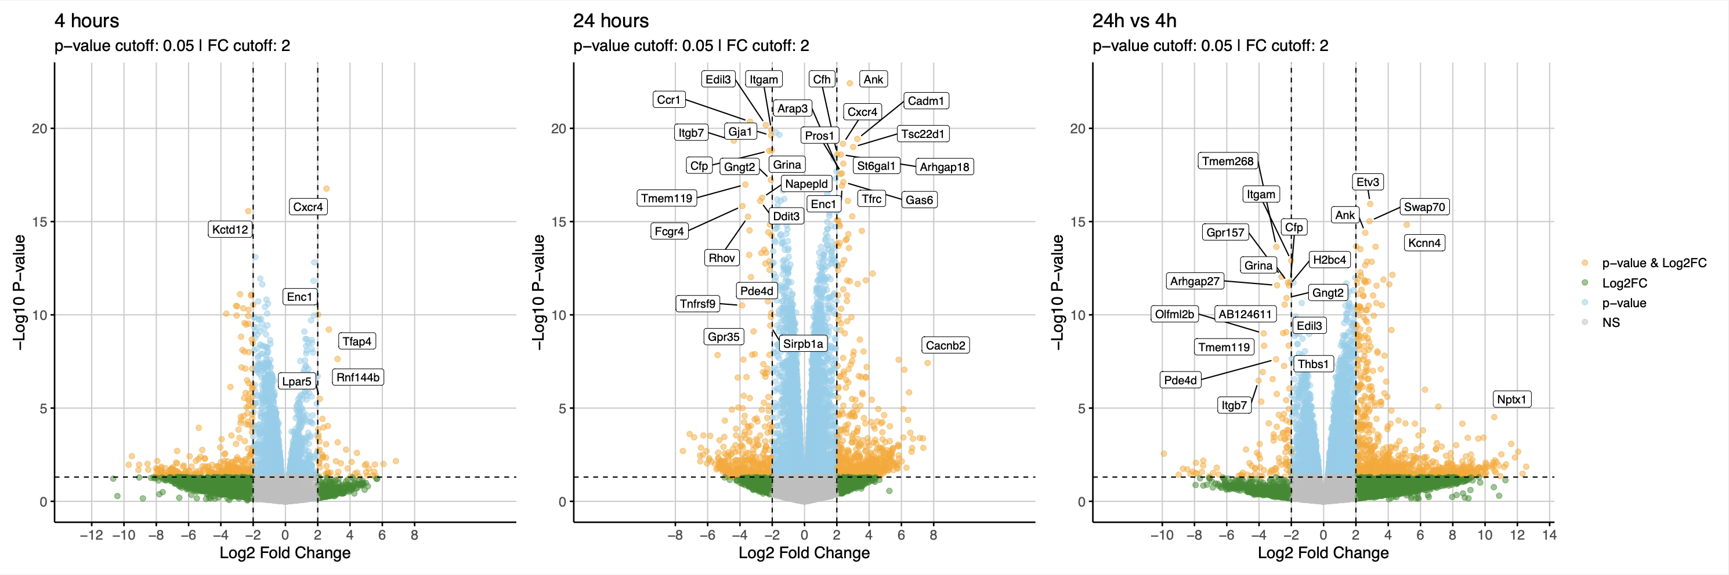
Differential Expression
STAR
STAR captures more varioation in the data
Kallisto

Slide 19
GSEA-granular RANKL contrasts: Hallmark
STAR
Kallisto

Slide 20
GSEA-granular RANKL contrasts: REACTOME
STAR
Kallisto

Slide 21
GSEA-granular RANKL contrasts: GO-BP
STAR

Slide 22
GSEA-granular RANKL contrasts: KEGG
STAR

